Slide 1
Video/Phone Counselling Feedback
Brief Intervention Service

Slide 2
Collated Results:
30 total participants. 16 video, 14 phone.
Gender: 70% Female, 26% Male, 4% Gender Diverse
Ages: 26% 18-24, 36% 25-34, 13% 35-44, 16% 45-54, 6% 55+
85% first time using a video/phone service. Others had used GP, Counselling, and Physio.
All stated it was helpful to see their clinician and/or use a phone service. 94% ‘very’ or ‘extremely’ helpful.

Slide 3
Collated Results:
All participants, bar one (phone), found it ‘easy-extremely easy’ to engage with their clinician using video/phone counselling.
33% of participants were ‘likely/very likely’ to use video/phone OVER in-person, with 23% being ‘somewhat likely,’ and equal distribution of the remainder preferring in-person. However, 60% were ‘likely/very likely’ to opt for video/phone if it meant a shorter wait time, with an additional 30% being ‘somewhat likely.’
Most participants were ‘somewhat likely’ (or more) to recommend video/phone to whanau/friends seeking support.

Slide 4
Collated Results:
50% (30% video, 20% phone) found video/phone counselling ‘about the same’ as in-person counselling, with 23% (13% video, 10% phone) finding it ‘better’ or ‘much better.’ Only 16% found it ‘worse/much worse’, with the remainder not applicable.
Nil significant technical (or otherwise) issues utilising video/phone service. Doxy.me had minor audio issues with one user, and another had connection issues that were resolved.
77% found they achieved their “goals of counselling” either ‘mostly’ or ‘entirely,’ 17% ‘somewhat,’ and just 6% ‘not at all.’
See final two slides for additional comments.

Slide 5
Results

Slide 6
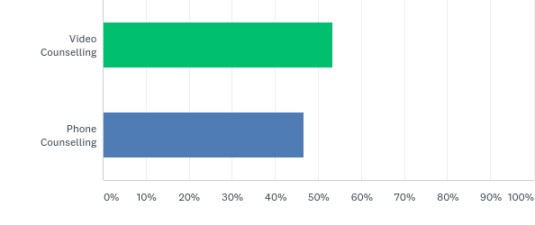
Q1: Did you use phone or video counselling? If you used both throughout your counselling, please choose the option you used the most.
Answered: 30
16
14

Slide 7
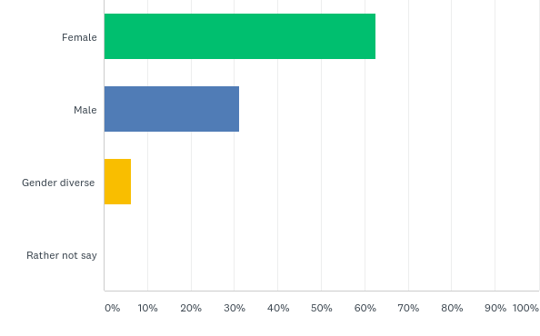
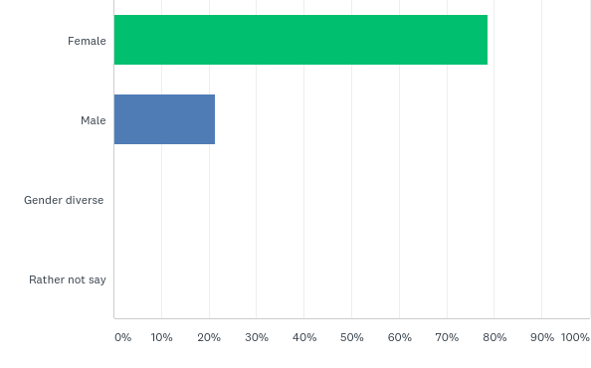
Q2: What is your gender?
10
11
5
3
1
Video
Phone

Slide 8
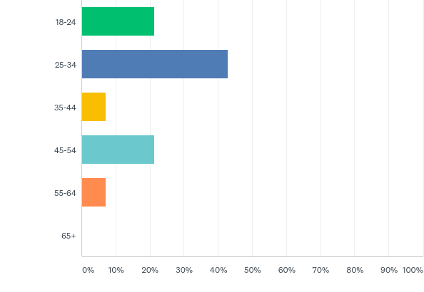
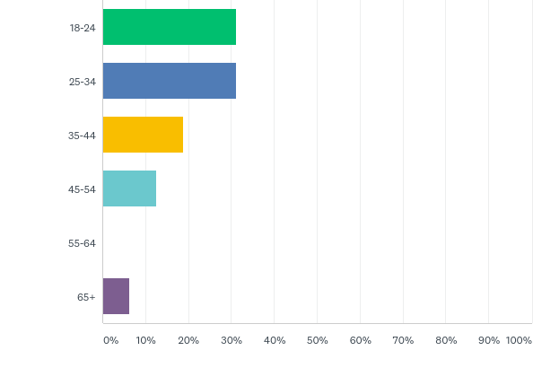
Q3: How old are you?
3
5
5
6
3
1
2
3
1
1
Video
Phone

Slide 9
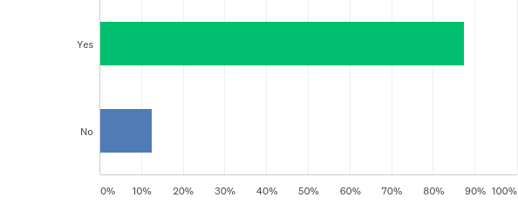
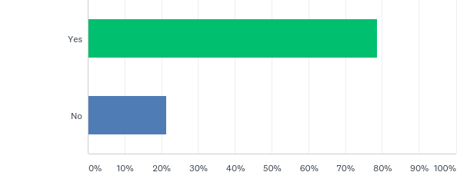
Q4: Was this your first time using a health based video/phone service?
14
11
2
3
GPx1, Counselling x1
3x GP, 1x Counselling, 1x Physio
Video
Phone

Slide 10
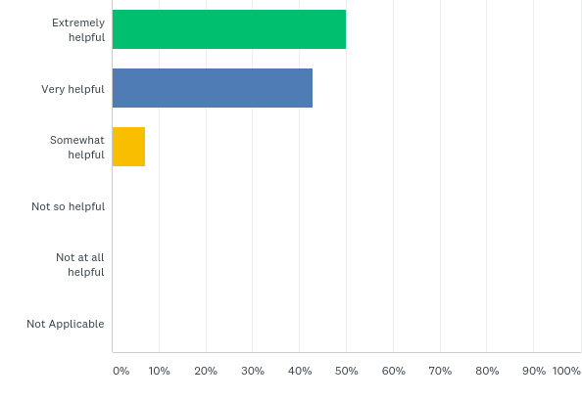
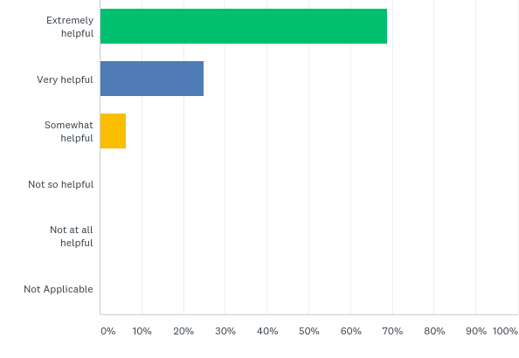
Q5: How helpful did you find it to be able to see your clinician? (use phone counselling?)
7
11
6
4
1
1
Video
Phone

Slide 11
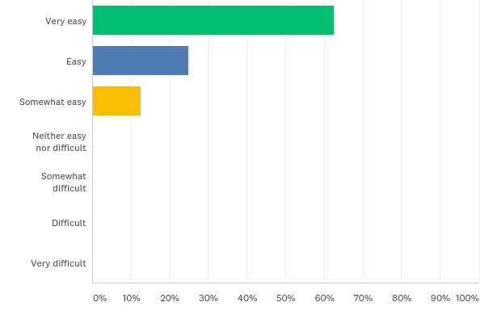
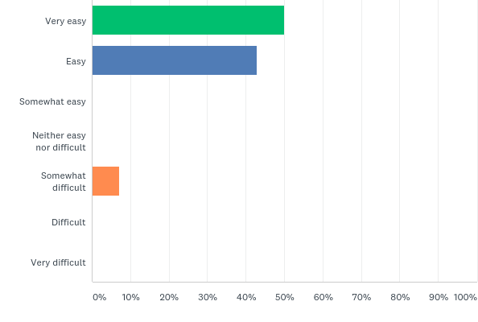
Q6: How easy did you find it to engage with your clinician via video/phone counselling?
10
7
4
6
2
1
Video
Phone

Slide 12
Q6: How easy did you find it to engage with your clinician via video/phone counselling? Comments:
“Easier over time. Was a bit to get used to at first.”
“Found it extremely easy - in fact I found it easier than if we were in the same room - for some reason I was a lot more relaxed over the video - maybe because the screen was like a security blanket.”
“Started well and just got better. Debbie is great.”
“Had a few delays with sound but we put it down to bad weather.”
“Easier over time” x2
“I found it easy to take more”
“I find it hard to open up in general, but I think in some ways in was easier to communicate over the phone without distractions.”
“No I found it easier & more relaxing to talk over the phone - I felt relaxed in my own personal space.”
Video
Phone

Slide 13
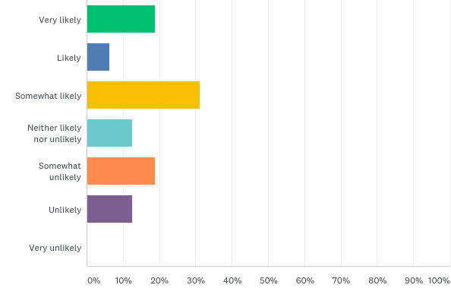
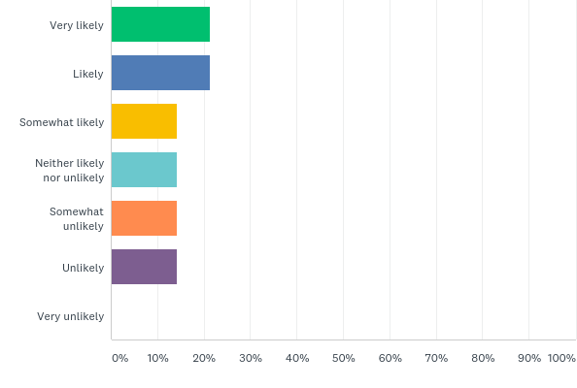
Q7: If given the option, how likely would you be to engage via video/phone counselling rather than in-person?
3
3
1
3
5
2
2
2
3
2
2
2
Video
Phone

Slide 14
Q7: If given the option, how likely would you be to engage via video/phone counselling rather than in-person? Comments:
“Would appreciate first session or two in person before commencing via video/phone. Believe it would benefit connection/relationship.”
“Just more personal face to face”
“I was a lot more relaxed. I didn’t have to travel.”
“I like the privacy of meeting face to face as it’s more of an intimate thing”
“It just feels more authentic in person”
“I enjoy face to face contact but I would be really stupid to endanger Debbie's health in any way”
“I really like my councillor but we aren’t based in the same place so I really enjoy video chatting”
“Harder to connect while online. Better connection in person”
“What ever is easiest for the person, i.e. work place could be different location”
“Difficult to make sure I am uninterrupted in my house.”
“It’s my first time using a counselling service and doing it on the phone made it easier for me as it’s less personal”
“Privacy, felt safer in my personal space, possibility of out of hours counselling eg: after 5pm, I also felt I could better absorb what was being said & could also take notes as didn't needing to make eye contact etc”
“Ease of access, i.e. no issues with parking and parking wardens, travel etc” x2
“I prefer face to face”
Video
Phone

Slide 15
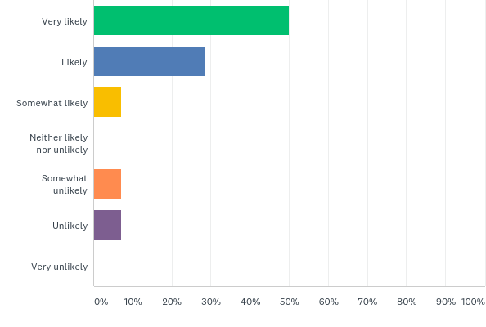
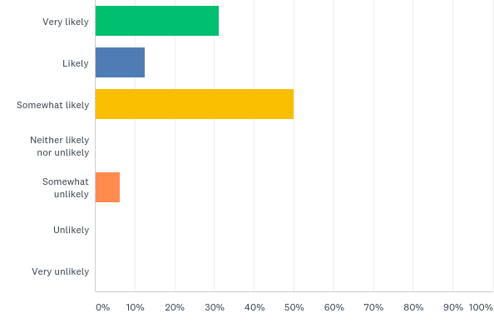
Q8: If it meant you would be able to engage in counselling sooner, how likely would you be to choose video/phone counselling over in-person?
7
5
4
2
8
1
1
1
1
Video
Phone

Slide 16
Q8: If it meant you would be able to engage in counselling sooner, how likely would you be to choose video/phone counselling over in-person? Comments:
“Yes. It would mean I would get it when I need it . And maybe by the time you get to me I would be still alive. I feel that the time it takes for you to get to the person in need is too late”
“As above – 1st time, phone easier as less personal”
“For me the wait time was difficult - it was approx. 4-6 weeks before my first appt (which had been explained) but at the time I was referred for counselling, was the time my need was highest, so if I could speak to someone by phone sooner, it would definitely be beneficial”
“Again with the parking and parking wardens”
“Cutting wait times would be great”
“The sooner you start something the better it is”
“Usually because the wait is so long”
“Due to video chat I’ve been able to talk with a councillor faster”
Video
Phone

Slide 17
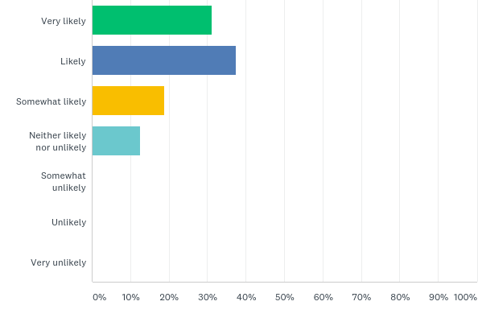
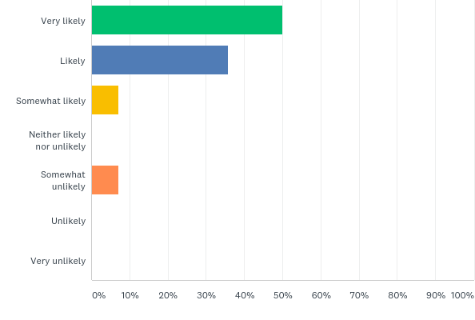
Q9: How likely is it that you would recommend video/phone counselling to your friends/whanau seeking support?
5
7
6
5
3
1
2
1
Video
Phone

Slide 18
Q9: How likely is it that you would recommend video/phone counselling to your friends/whanau seeking support? Comments:
“With luck you will get to them before it is too late for them. If you know what I mean”
“My personal experience was very positive”
“Works just as well as face to face and can be more convenient for those who are busy with work, kids or live out of town.”
“Ease of access and privacy more easily maintained”
“It is better than nothing”
Video
Phone

Slide 19
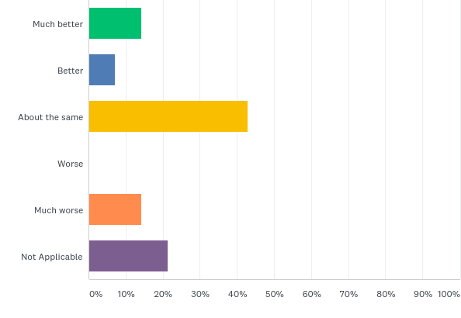
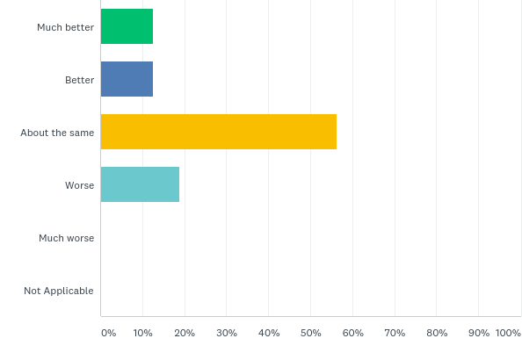
Q10: If you've had previous in-person counselling experiences, how did you find it compares to video/phone counselling? Was video/phone counselling:
2
2
1
2
6
9
3
2
3
Video
Phone

Slide 20
Q10: If you've had previous in-person counselling experiences, how did you find it compares to video/phone counselling? Was video/phone counselling… Comments:
“Just more personal body language pick ups etc”
“I was a lot more relaxed and engaged”
“I think it depends more on the counsellor/therapist...”
“Keeping me calm and lowering stress and anxiety no matter how it’s done is good for me”
“After 2 sessions the counsellor told me that she could not do anything for me so no point coming. So I didn't. That was in Oamaru.”
“On the phone you can focus on the counsellor's voice & what they are saying to you there are no visual distractions. In a small town/city going into an office there is the fear of bumping into someone you may know - which has happened to me twice - I love the total privacy that phone counselling offers.”
Video
Phone

Slide 21
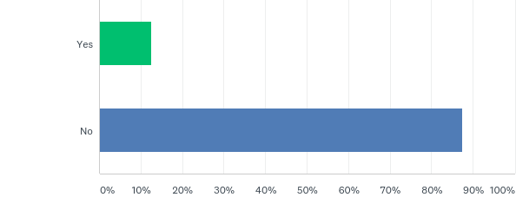
Q11: Did you have any difficulties using video/phone counselling, or accessing the 'waiting room' in the link sent by your clinician?
2
14
Video
1x crackling noises – nil elaboration. 1x loading issues, resolved at 2nd attempt.
Nil Phone Session issues.

Slide 22
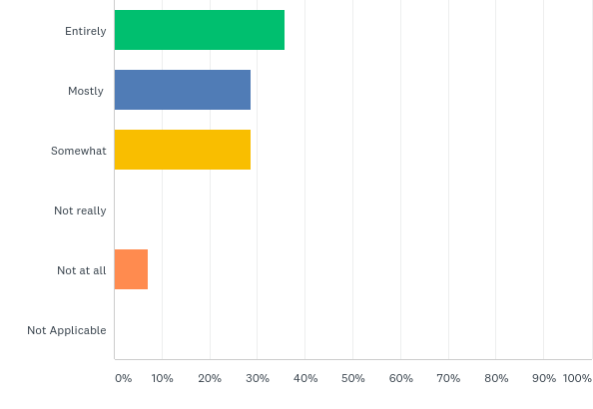
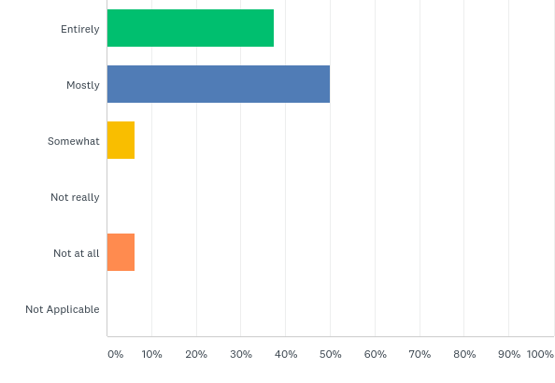
Q12: In thinking about the goals you had in counselling, were you able to achieve these using video/phone counselling?
5
6
4
8
4
1
1
1
Video
Phone

Slide 23
Q12: In thinking about the goals you had in counselling, were you able to achieve these using video/phone counselling? Comments:
“By being responsible to take action myself (worksheets/info sheets) and then discussing my thoughts/actions was very helpful in my healing process.”
“As by that time I was better. But I could have just as easily been dead” – Not at all
“For me this worked perfectly.”
“The online resources given really helped with achieving my goals it was like being given an assignment and then working on implementing it till your next consult”
“My situation kept evolving during lockdown so my counsellor had to keep adapting their counselling strategy to help me”
“I was a lot more open and relaxed which meant I was a lot more focussed on what was happening”
Video
Phone

Slide 24
Q13: Do you have any other comments or feedback about using video counselling?
“Would prefer to use video counselling than face to face. Video is more convenient time wise and money wise. e.g.: petrol/parking/traffic.”
“It was better than I thought it would be”
“Extremely thankful that I have been able to stay in contact with my councillor during this period”
“It was great - and Debbie is a fantastic counsellor. I am going to miss our sessions.”
“Keep it up we all need to be safe . If we have sick counsellors no one gets their benefit and we all suffer.”
“Worked really well. Counsellor was great.”
“Would be more helpful for people needing immediate help. I'm looking for long term personal help and I find this too stiff.”

Slide 25
Q13: Do you have any other comments or feedback about using phone counselling?
“Very easy to talk and support was good.”
“I appreciate the prompt and friendly service. It has made a difference. Knowing someone was there to listen and support me I am better to take steps to help myself.”
“No, just to say it comes far too late”
“I found it was easily accessible and less confronting, more like having a friendly professional conversation that encouraged me to move forward.”
“It was a relief for me knowing that it was over the phone and not in person”
“Today I was stuck on a work phone call when my counsellor rang. But I was able to quickly call her back - if I was traveling to an office it would be more time lost - for me phone counselling was more comfortable, relaxing, focused, private, time efficient,& less stress & less pressure :)”
“Very convenient. Sometimes I find face to face intimidating or overwhelming emotionally. Phone was much better for me”

